Slide 1
Topics
Spring AOP.
Spring AOP Terminologies.
Examples
Transaction Management

Slide 2
Spring AOP
Spring AOP is about modularizing cross cutting concerns.
Cross cutting concerns are any functionality that affects multiple points in an application.
Transaction management, Security, Logging are all examples of concerns.
In spring AOP cross cutting concerns can be modularized into special classes called Aspects.

Slide 3
AOP Terminologies
Aspect
  Cross cutting concerns that come across multiple points in an application. Spring modularizes this into a class called aspect.
Joinpoint
  The point within actual code were the aspect get executed . Spring Jointpoint is always a method call.
Pointcut
  An expression that selects Jointpoint for execution

Slide 4
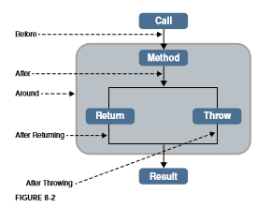
AOP Terminologies
Advice
  The action taken by an aspect at a particular jointpoint.
  There are 5 kinds of advice.

Slide 5
Spring AOP Terminologies
Target object
  Object being advised by an aspect.
Weaving
  The process of wiring aspects to the target object.

Slide 6
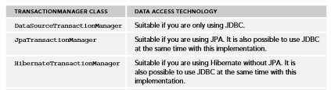
Transaction Management
A transaction is a unit of work that either completes successfully (100%) or rollback successfully (0%)
Spring transaction model is based on PlatformTransactionManager interface.

